Slide 1


Notes:
Explain that this assembly is to introduce miMove and to make sure all students know what the app is, why your school is going to use it and what they have to do to start using it

Slide 2

We want you to use physical activity to
make your life better
Notes:
Physical activity can help us flourish in many ways. People usually think about the benefits to our mental and physical health – it reduces the risk of illnesses, helps us stay calm and not be stressed etc. However, people take part in different types of physical activity for lots of reasons for example, some people just love it, some find it brings excitement, wonder and a huge feel-good factor to their lives. Some people love meeting challenges and some really enjoy competing, For some it brings structure knowing that every Tuesday evening they go to Karate class, for example. There are lots of social benefits with many people making friends through physical activity. But whatever the reason you chose, we want physical activity to make your life better and to help you we have opened a miMove account for each of you.

Slide 3



What is miMove?
AN APP THAT ALLOWS YOU TO LOG YOUR PHYSICAL ACTIVITY
THIS ACTIVITY DATA IS THEN SHARED WITH US
WE WILL USE THIS DATA TO SUPPORT YOU.

Slide 4
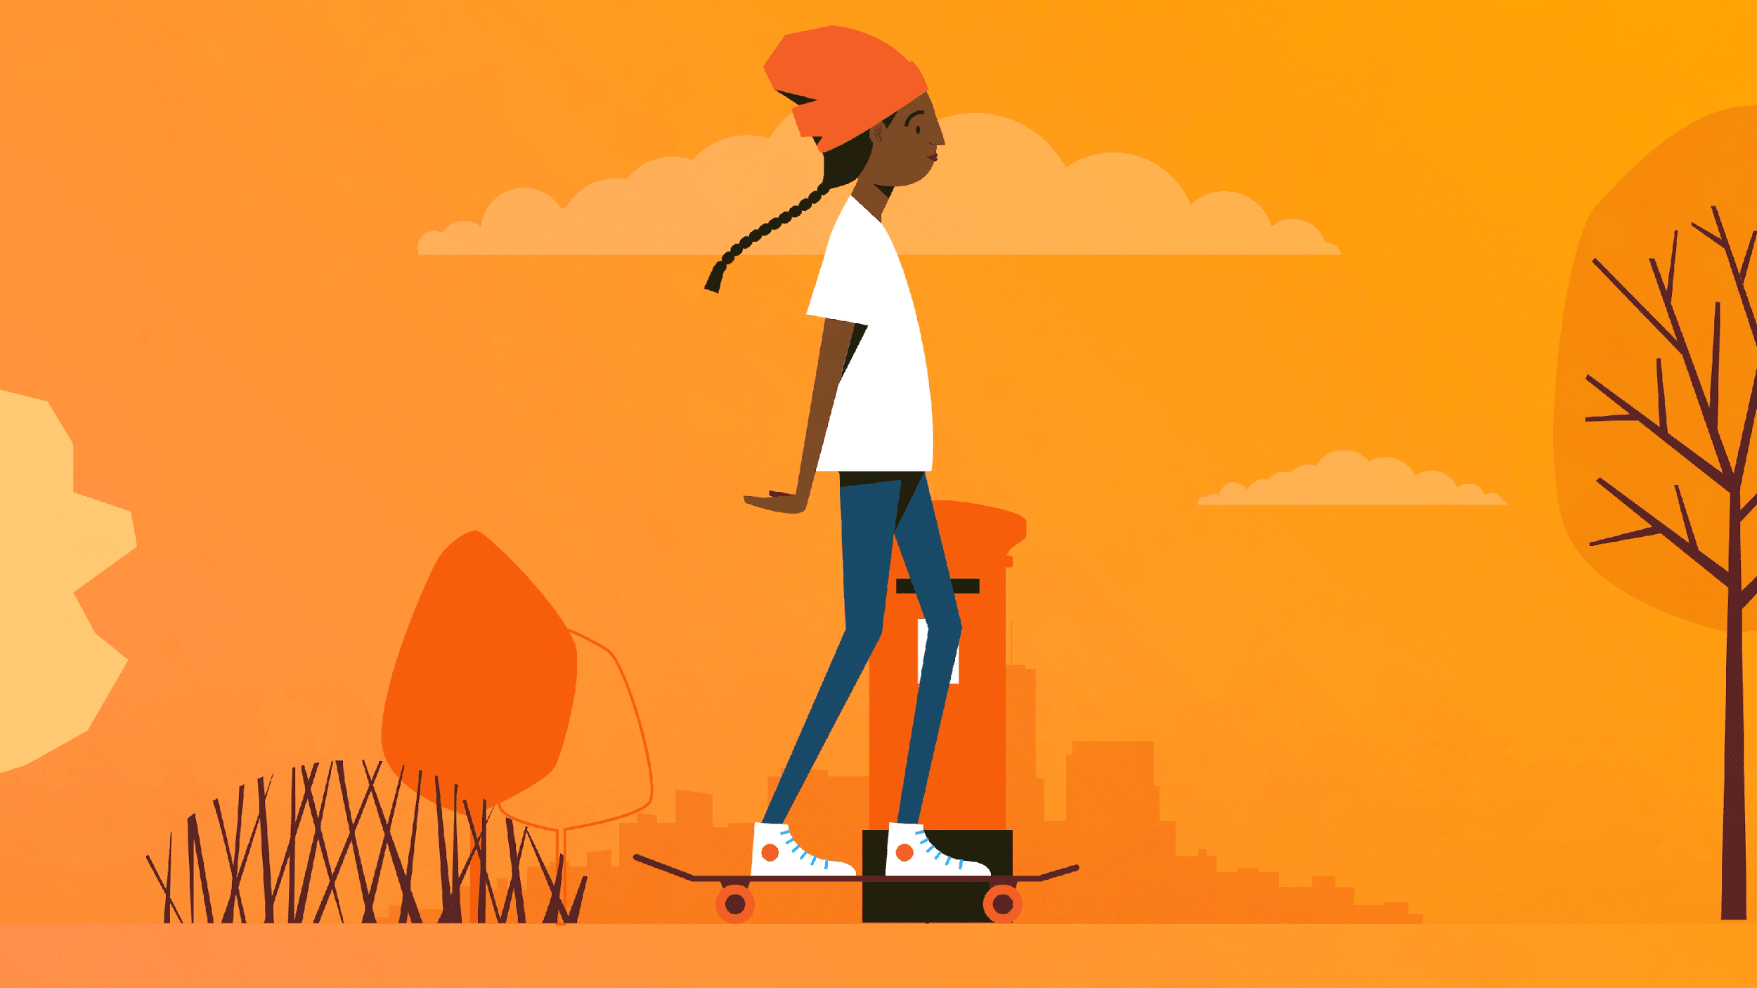
What counts as physical activity
Anything
All physical activity is good activity
Some people are into sport and some are not and that’s fine
Whatever you do…LOG IT on miMove.
Notes:
We believe that all activity is good activity. Some people are into sport and some are not and that’s fine. Whatever you do, log it. If you go swimming with your friends, walking with family, skateboarding, bike riding, frisbee throwing, free running, or dancing...miMove it.

Slide 5
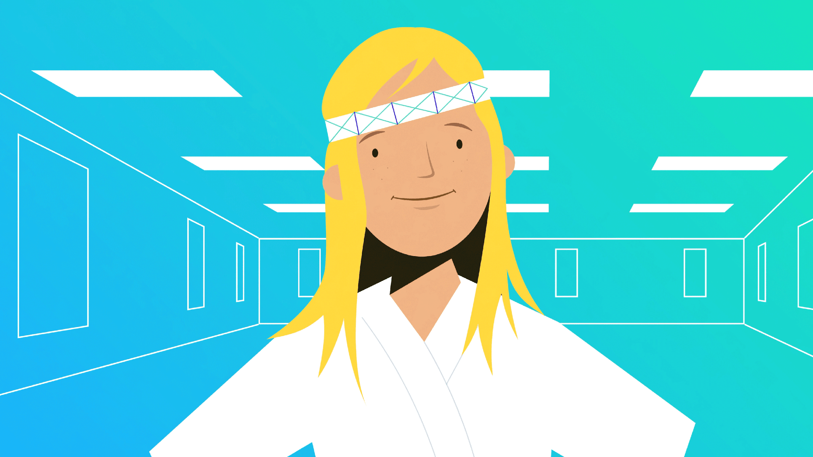
Why are we using miMove
We want all our students to develop a physical activity habit
Therefore we need to know who does what activity
This data will help us SUPPORT YOU
The data will help us do a better job.
Notes:
Why should we use miMove?
We want all our students to develop a PA habit
We want to SUPPORT YOU and to use the data to be able to do a better job.
The goal of P.E. is to ensure that all young people have what is needed to be able to be physically active. The best evidence for this is to see your levels of physical activity. It’s a little like the English department asking you to keep a reading log.
We want to celebrate those who are active and support you in staying active.
We will get very excited about those of you who become more active and we will work hard to help you stay active
If you are not active, we need to know what we can do to help you.

Slide 6
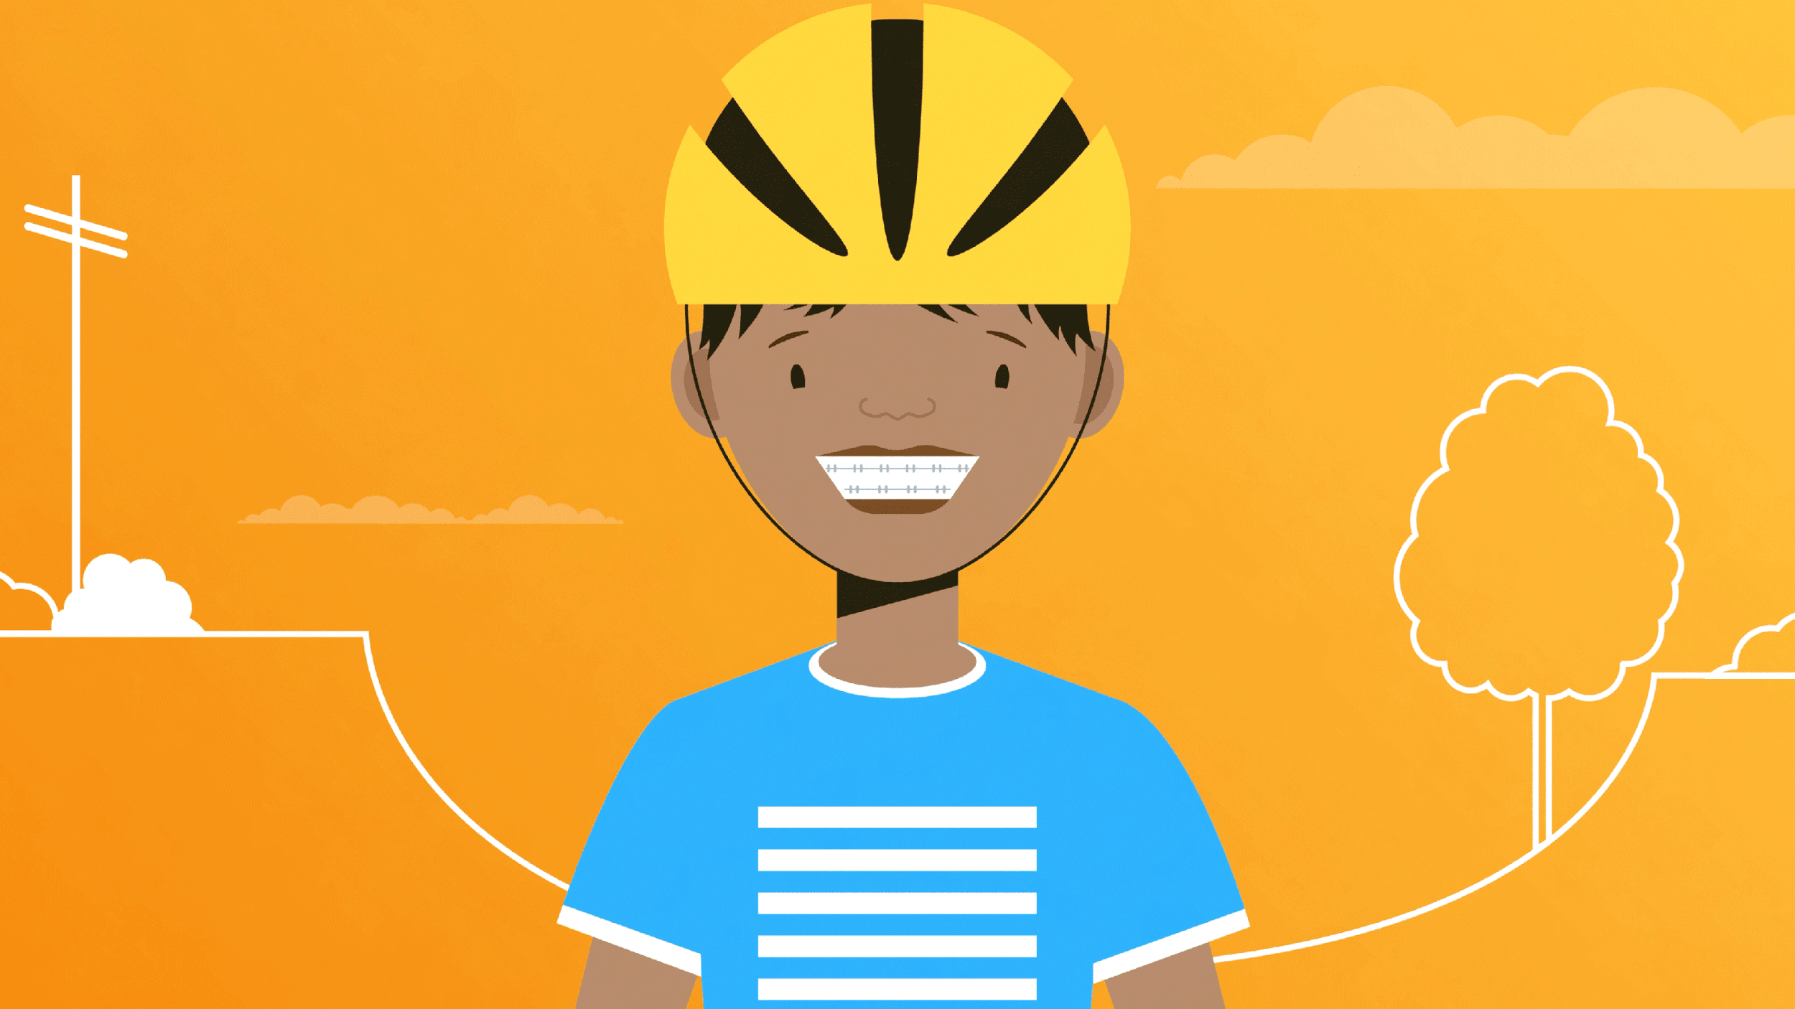
What is success
Overcoming barriers and challenges in order to be physically active
Moving from inactive to active
Increasing the amount of activity you do
Sustaining activity levels
Making physical activity a normal and regular part of your life
Notes:
We want to be able to celebrate your efforts. We want to celebrate those who are active and support you in staying active.
We will get very excited about those of you who become more active and we will work hard to help you stay active. We will work hard to support those of you that have challenges to overcome in order to take part in regular physical activity.
If you are not active we need to know how we can support you.

Slide 7

Who will see your data
Your class teacher and the PE coordinator
Your parents/carers if they download the app on their devices
We will discuss your success with your parents/carers at Parents Evening
NOBODY ELSE
Notes:
Who will have access to your account?
Designated teachers
Your parents if they download the app. We will look at and discuss your activity data at parents evening.
Other students will not see your data.

Slide 8






miMove is not….
A competition
A league table
A way for us to judge you
A reward scheme
A fitness scheme
Notes:
miMove will not be used to judge you. We will not make league tables. There will be no forced activity.
Not a competition
Not a reward scheme
THEREFORE there is no reason to be dishonest about your activity. If anything you’ll feel silly when it comes to light. Integrity is important. More important to be honest than active (but it’s great to be both)

Slide 9





What you need to do ...
Talk to your parents/carers about the email and letter.
Download miMove on your phone or tablet from App Store or Google Play
Use the username and password that we will give you to log in
Change your password when prompted
Remember to log every activity you do
Notes:
We will tell your parents about the app by email/letter/meeting
Download the app on mobile device (phone or tablet) not laptop
We will issue you with a username and password. You will be asked to change your password the first time you log in. WE DO NOT HAVE ACCESS TO YOUR NEW PASSWORD SO DON’T FORGET IT.
You only need to enter username and password the first time you log in.
You need to: Download and log in before [insert date]
Your parent(s)/careers will be notified and we will suggest they download the app to access your account too.

Slide 10
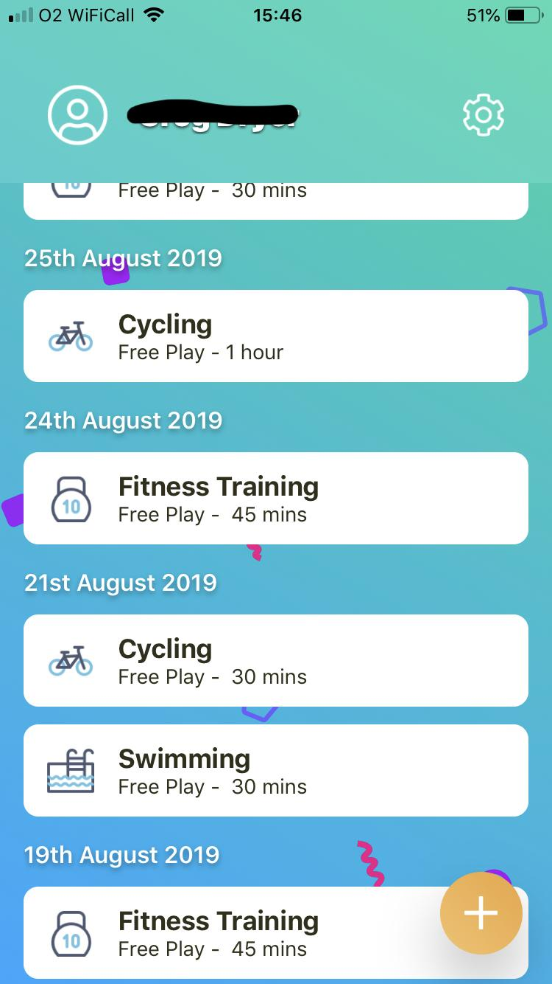
How to log an activity 1/6
Tap the + to start
Notes:
It is easy to use.
Logging activity takes a few seconds.

Slide 11
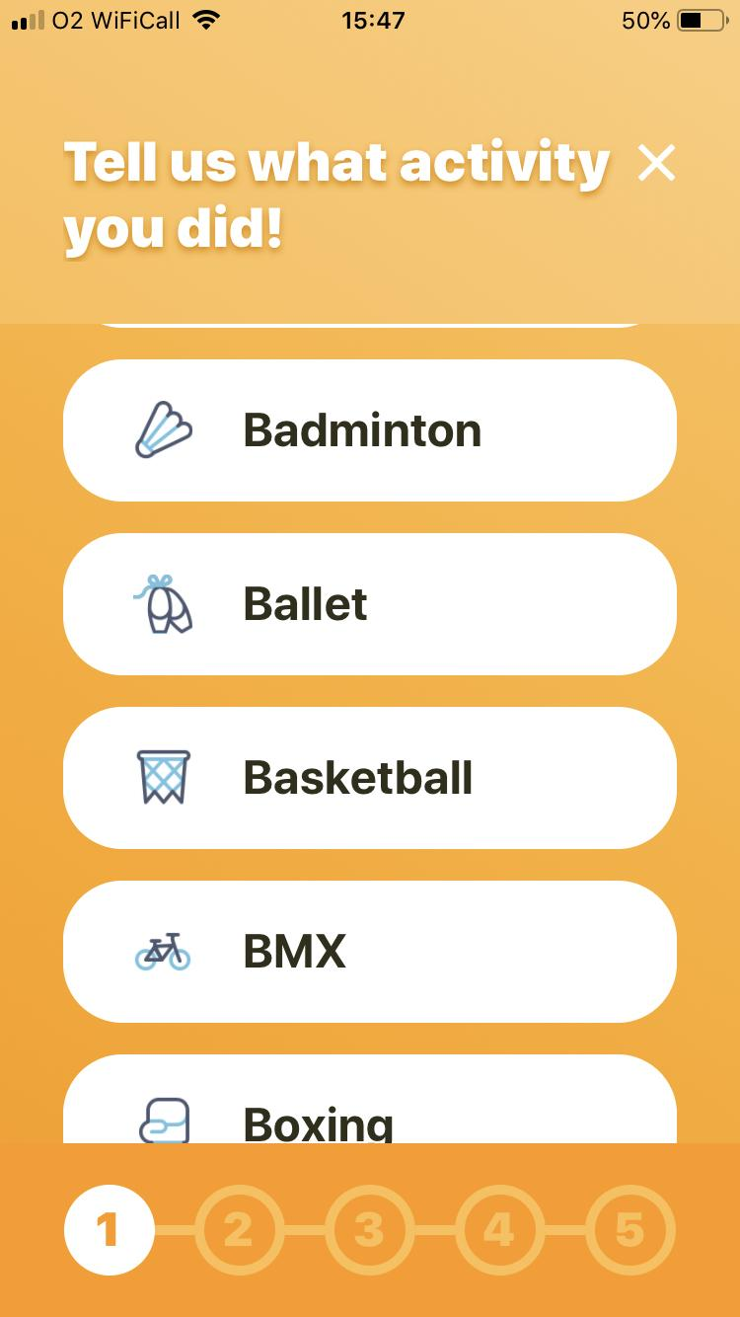
How to log an activity 2/6

Slide 12
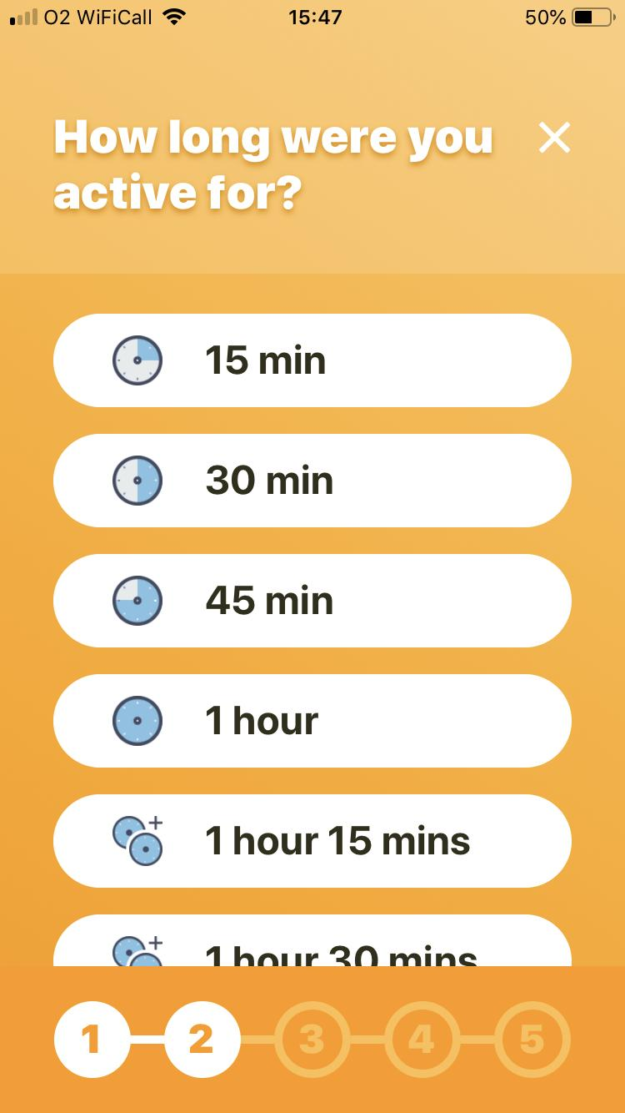
How to log an activity 3/6

Slide 13
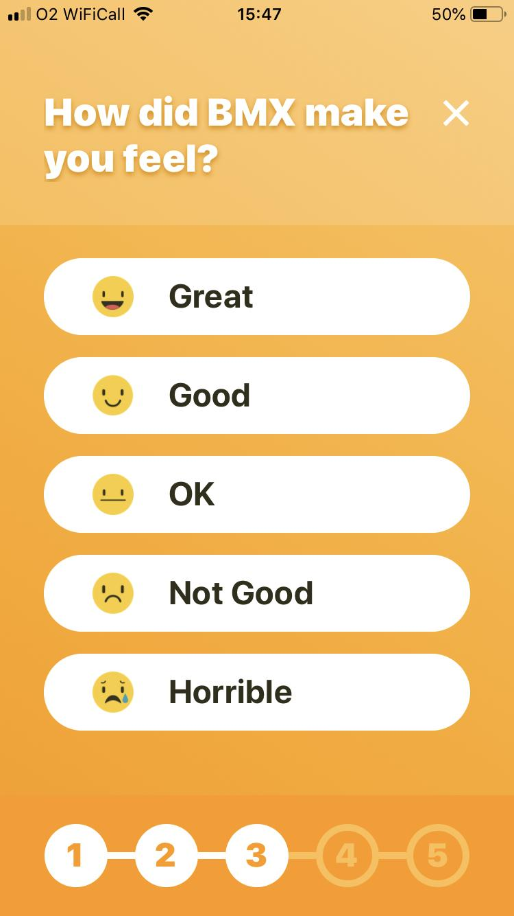
How to log an activity 4/6

Slide 14
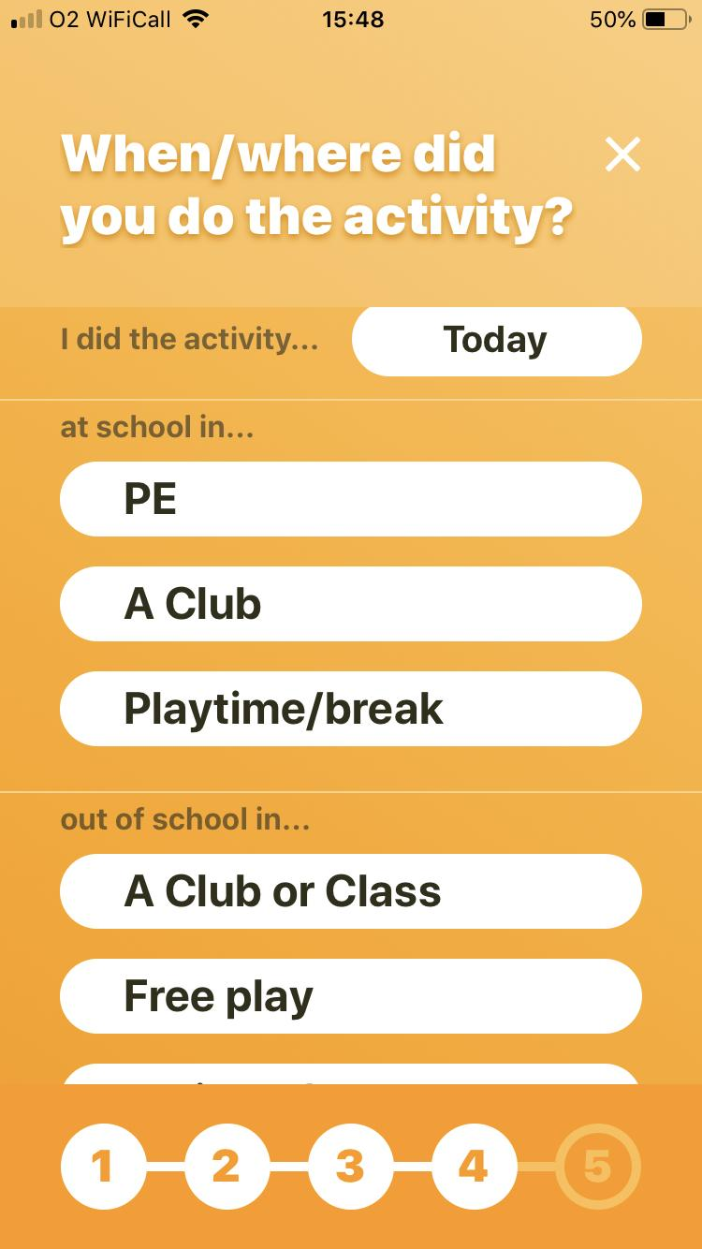
How to log an activity 5/6
You only need to change this if you are logging activity that you have done on previous days.

Slide 15
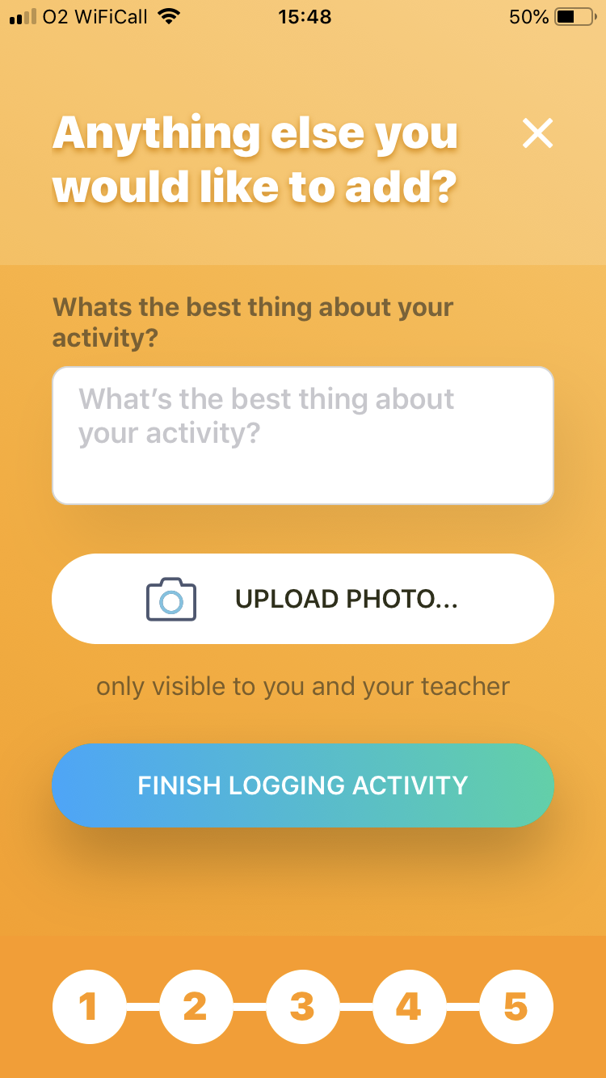
How to log an activity 6/6

Slide 16
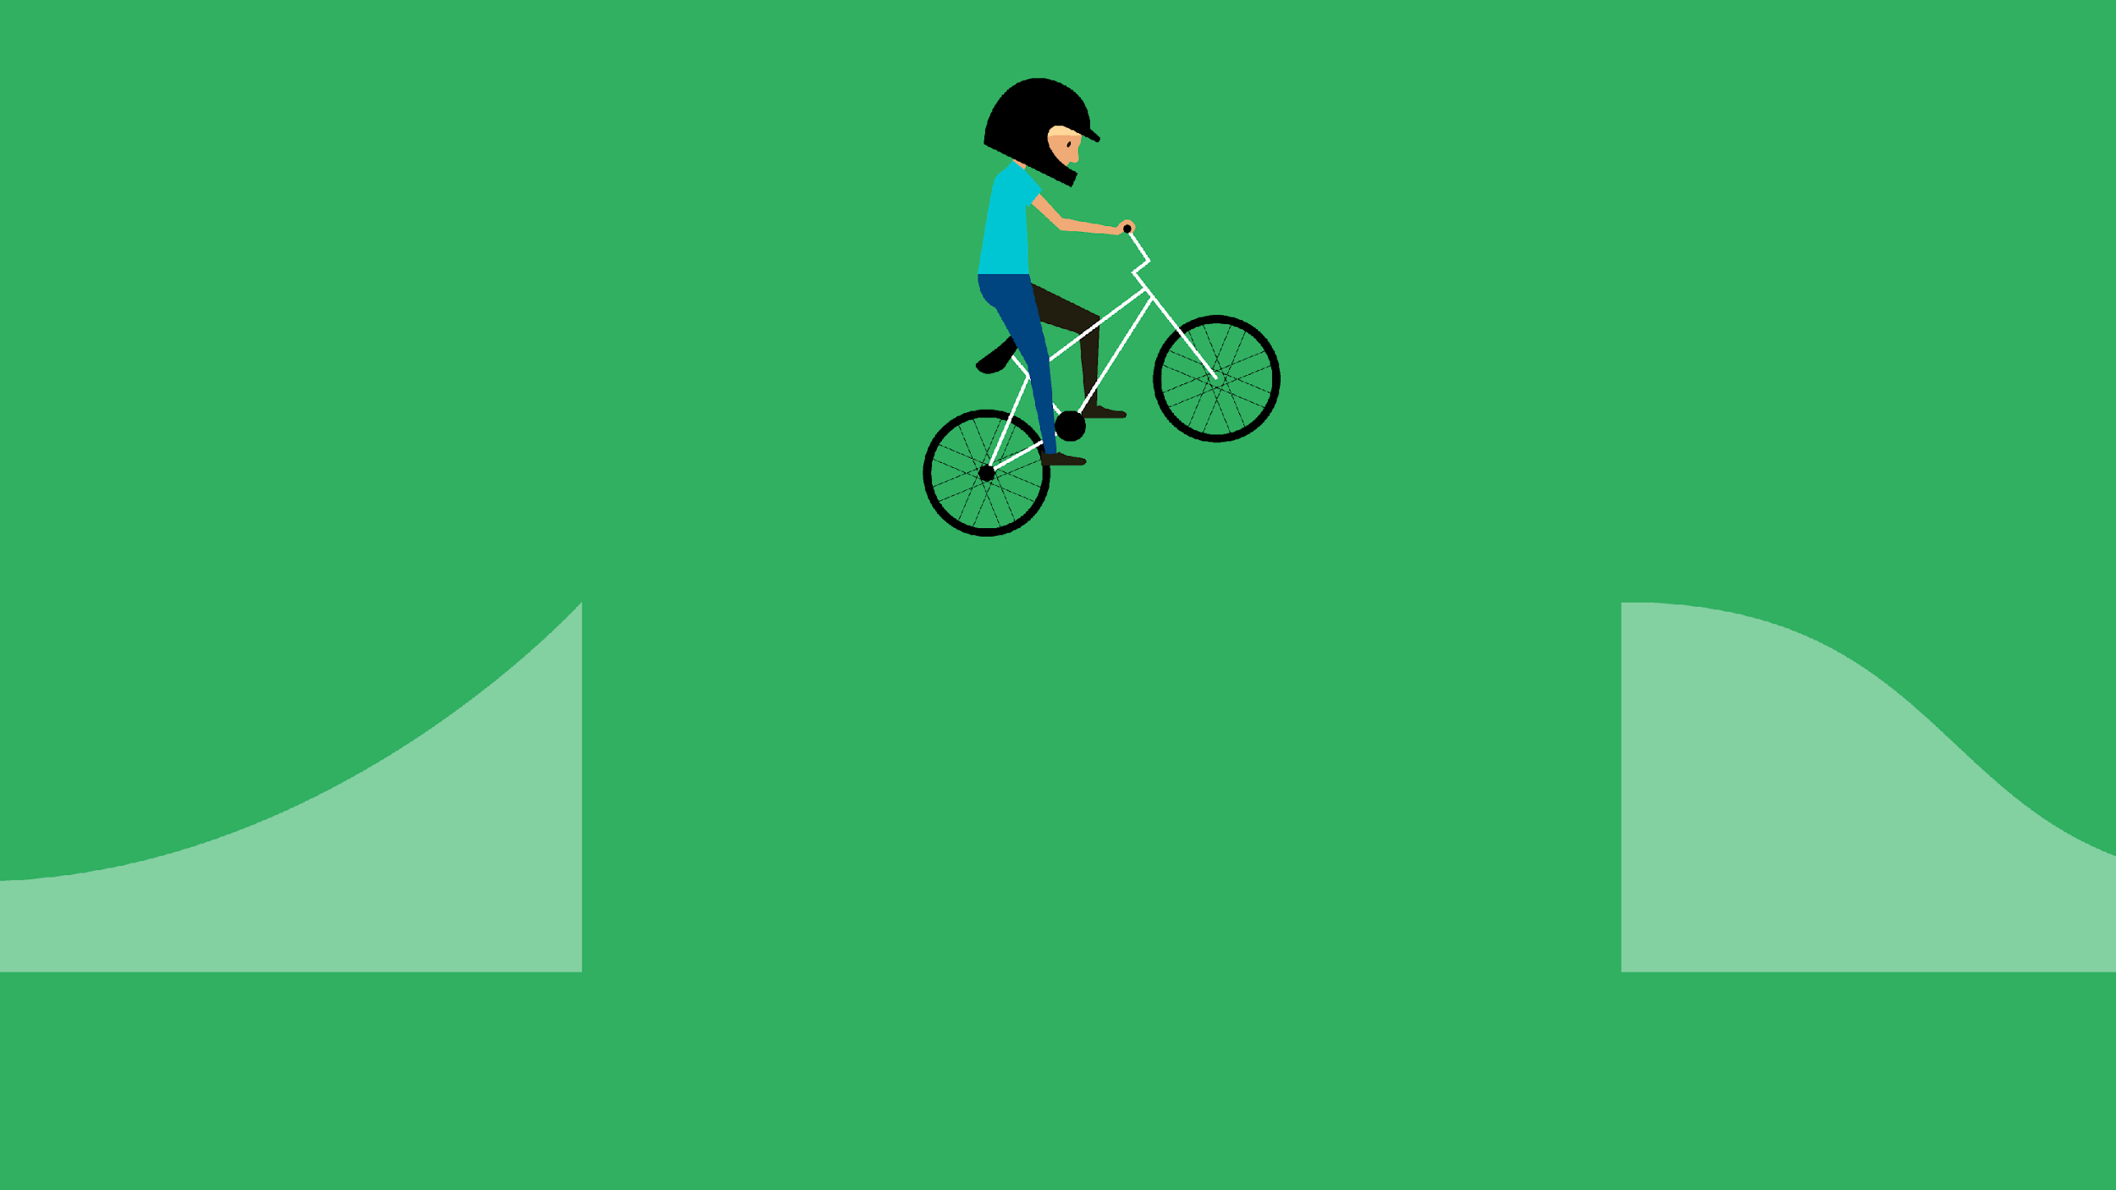
Launch
We aim to launch with as many children in Years 3 to 6 as possible.
By Monday 11th May, everyone should have logged in and recorded their activity
Any questions, please ask Ms Pearce.

