Slide 1



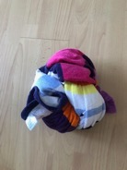



INSTRUCTIONS
WELCOME TO OUR FOOTBALL FREESTYLE WEEK
Choose your level: Bronze, Silver, Gold or Platinum.
Can you complete all 3 challenges within that level.
If you start at Bronze or Silver can you progress to Gold or Platinum with practice and determination.
If you do not have a football use a tied up beach or bath towel or sock.

Slide 2



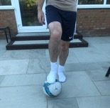
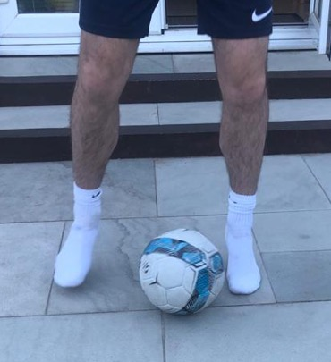
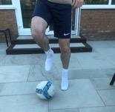
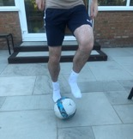
At Home Freestyle
Bronze Challenge 1: Toe Taps
Place the bottom of your foot on top of the ball.
Jump and switch your foot on top of the ball. Right, Left, Right, Left…
Can you do 10?
How fast can you do it?
1
2
3
Using the inside of your foot, move the ball from right to left as quick as you can between your feet.
Can you do 10?
How fast can you do it?

Slide 3
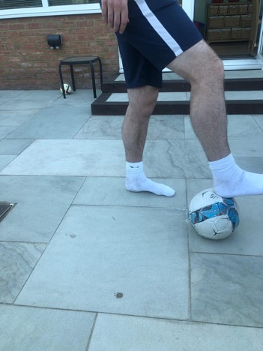
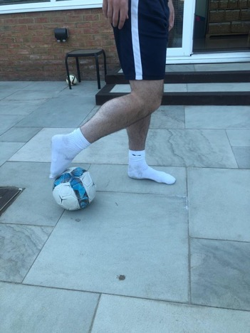
At Home Freestyle
Bronze Challenge 2: Heel to Toe Rolls
Start with the ball under your heel.
Using the bottom of your foot, push the ball back.
Stop the ball with your toe.
Repeat 10 times.
1
2
3

Slide 4





At Home Freestyle
Bronze Challenge 3: Squash the Ball
Can you squash the ball on the floor with your…
Chest?
Foot?
Bottom?
Knee?
Can you also stop the ball using the different body parts when it is rolled to you?

