Slide 1



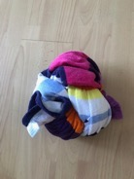



INSTRUCTIONS
WELCOME TO OUR FOOTBALL FREESTYLE WEEK
Choose your level: Bronze, Silver, Gold or Platinum.
Can you complete all 3 challenges within that level.
If you start at Bronze or Silver can you progress to Gold or Platinum with practice and determination.
If you do not have a football use a tied up beach or bath towel or sock.

Slide 2






At Home Freestyle
Silver Challenge 1: Around the Clock
2
One knee up, catch the ball.
Can you do it on your right and left knee?
One kick up, catch the ball.
Can you do it on your right and left foot?
1
3
One chest up, catch the ball.
4
Can you do each of these skills and then add one kick up?
Can you do each of these skills whilst sitting down?

Slide 3
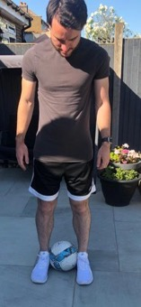
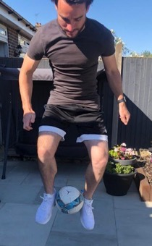
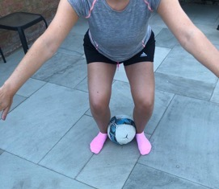
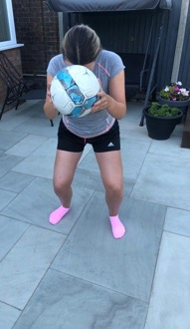
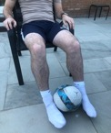
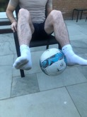
At Home Freestyle
Silver Challenge 2: Rocket Launcher
Ready Position:
Bend your knees and put your arms out for balance.
Landing Position:
Land safely on two foot and either catch the ball or kick it in the air once.
2
4
3
1
Starting Position:
Place ball firmly between your feet.
Jump Position:
Jump your knees up in the air and release the ball.
Can you also do it sitting down on a chair or on the floor?

Slide 4
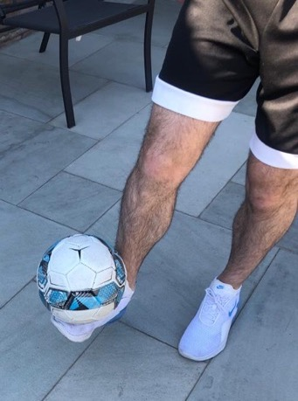
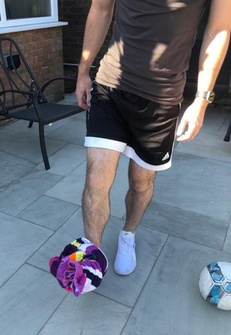
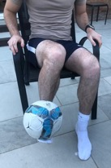
At Home Freestyle
Silver Challenge 3: Foot Balance
Place the ball on top of your foot.
Once the ball is secure, take your hands off.
Count to 5 seconds and then scoop the ball up and catch it in your hands.
Can you do it on your right foot and then your left foot?
Can you do it sitting down on a chair or on the floor?

