Slide 1



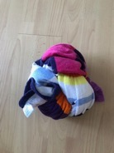
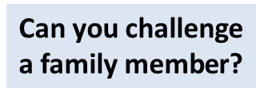


INSTRUCTIONS
WELCOME TO OUR FOOTBALL FREESTYLE WEEK
Choose your level: Bronze, Silver, Gold or Platinum.
Can you complete all 3 challenges within that level.
If you start at Bronze or Silver can you progress to Gold or Platinum with practice and determination.
If you do not have a football use a tied up beach or bath towel or sock.

Slide 2



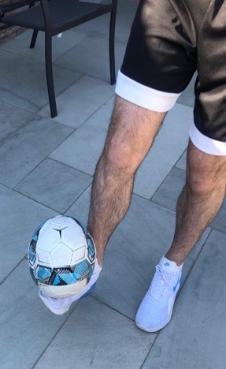
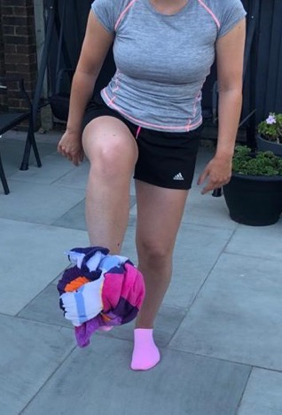
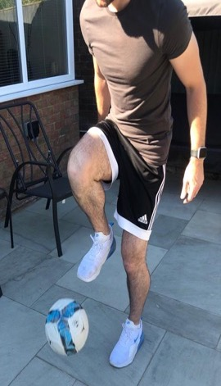
At Home Freestyle
Gold Challenge 1: Knee Snap
3
In one movement, pull your foot back and slam the top of the ball down with your knee.
2
Start to raise your foot as high as you can.
1
Balance the ball on your foot.

Slide 3
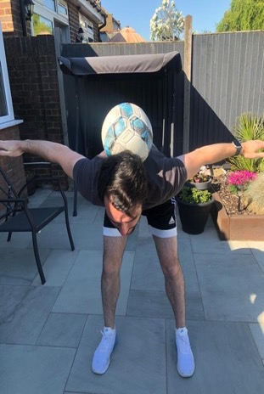
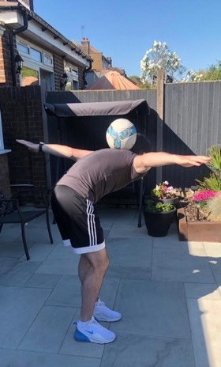
At Home Freestyle
Gold Challenge 2: Neck Balance
Slowly lean forward so your back is straight.
Place the ball behind your head and on top of your neck.
Lift your head up and look forward.
Take your hands off the ball and put your arms out for balance.
Can you spin in a circle keeping the ball on the back of your neck?

Slide 4
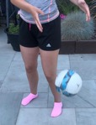
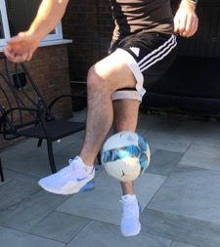
At Home Freestyle
Gold Challenge 3: Cross Kick
Have the ball in your hands.
Drop the ball over your left foot.
Jump in the air and cross over your left and right foot one behind the over. Kick the ball up with the foot behind.
If you need to, let the ball bounce and then kick it up.
3
2
1

