Slide 1



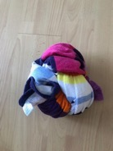



INSTRUCTIONS
WELCOME TO OUR FOOTBALL FREESTYLE WEEK
Choose your level: Bronze, Silver, Gold or Platinum.
Can you complete all 3 challenges within that level.
If you start at Bronze or Silver can you progress to Gold or Platinum with practice and determination.
If you do not have a football use a tied up beach or bath towel or sock.

Slide 2



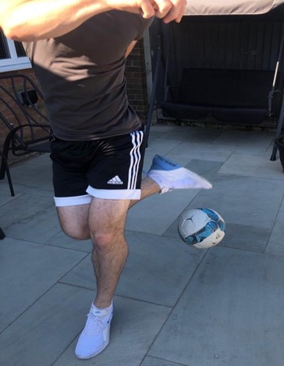
At Home Freestyle
Hold the ball in your hands.
Drop the ball on the left hand side of your body.
Jump in the air and move your left leg over the ball.
Using your right foot, slam the ball down using your laces.
Platinum Challenge 1: Side Step Slam Down
1
2
3
4

Slide 3
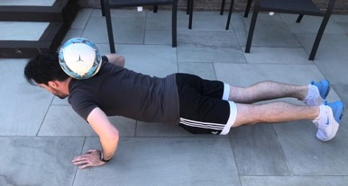

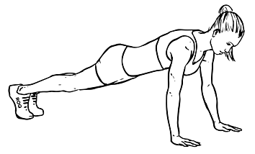
At Home Freestyle
Platinum Challenge 2: Neck Balance Press-Up
2
Slowly go down on one knee keeping your upper body as still as possible.
Put both hands down on the floor at the same time.
Place your other knee on the floor and move them backwards into a press-up position.
Start the press-up. Keep as still as possible.
Place the ball on your neck again.
1
3
5
4

Slide 4
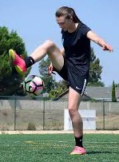
At Home Freestyle
Have the ball in your hands.
Drop the ball over your right foot.
In one motion, kick the ball with the outside of your foot and move your foot around the ball.
Kick the ball before it hits the floor.
Platinum Challenge 3: Around the World
1
2
3
4

