Slide 1
Accelerated Reader at Parkside
Year 2

Slide 2
Why Accelerated Reader?
To encourage reading for understanding.
To improve accuracy when reading.
To improve motivation/pleasure towards reading.
To expose the children to a wider range of texts (using the classroom library).
To increase the amount that children want to read.
To develop independence when reading.
To enhance progress!

Slide 3
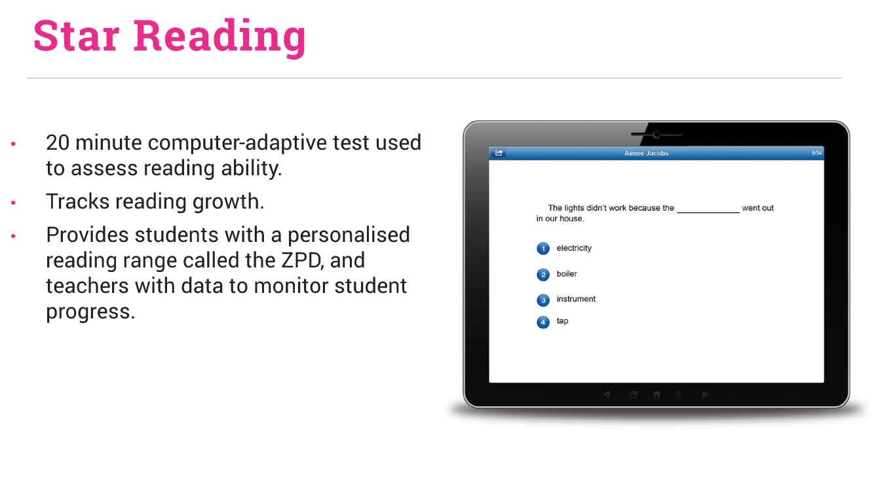

Slide 4
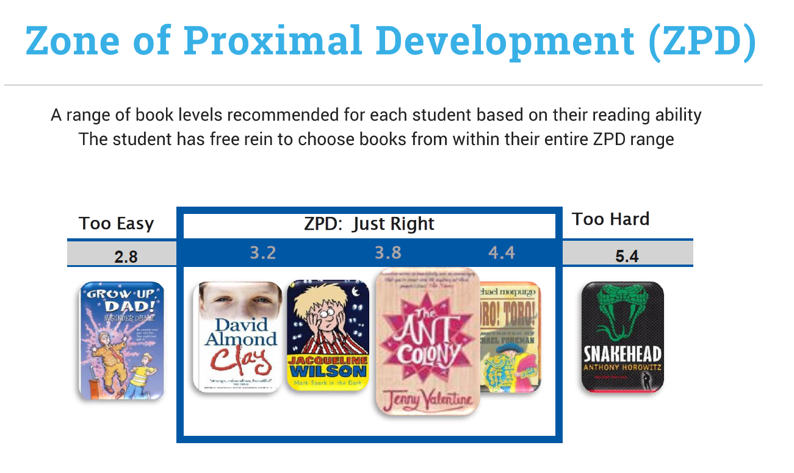

Slide 5
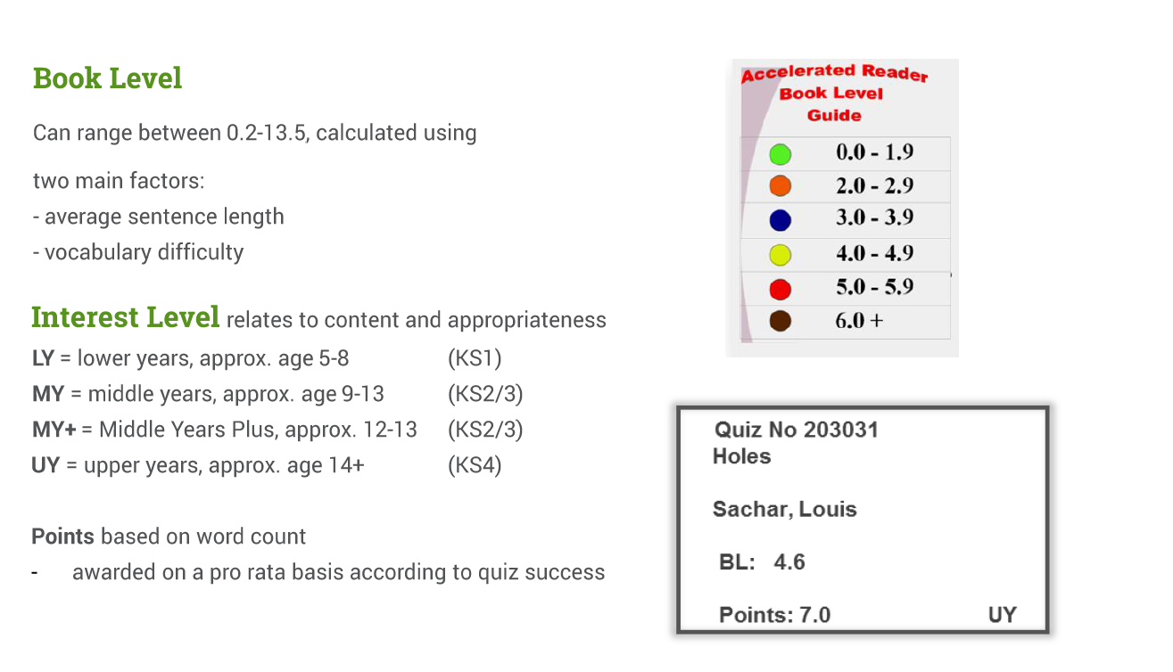

Slide 6
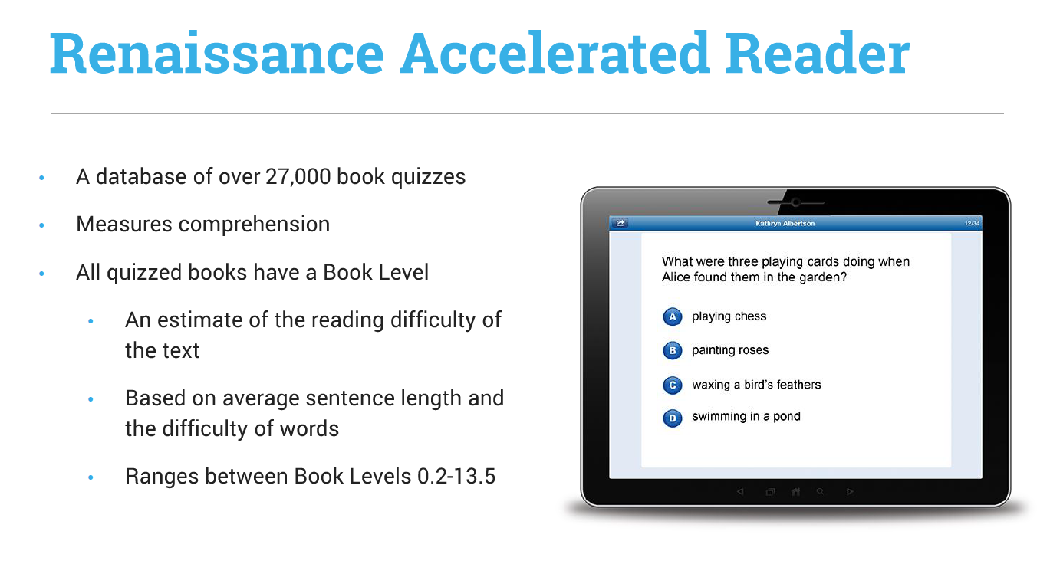
The children can only access Accelerated Reading at school.
The children don’t have a specific ‘book changing day’. When they have finished their book they can quiz the next day.

Slide 7
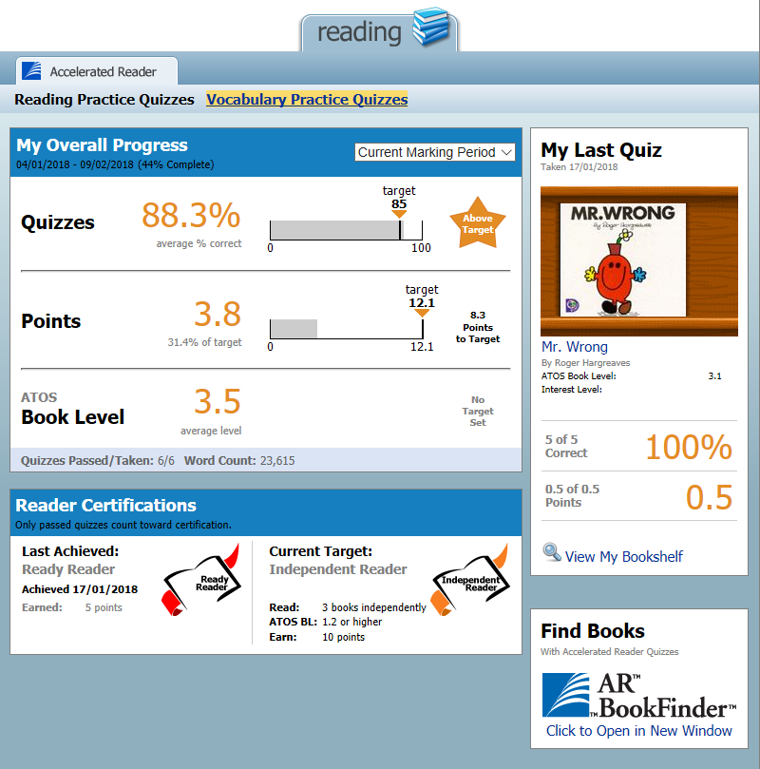
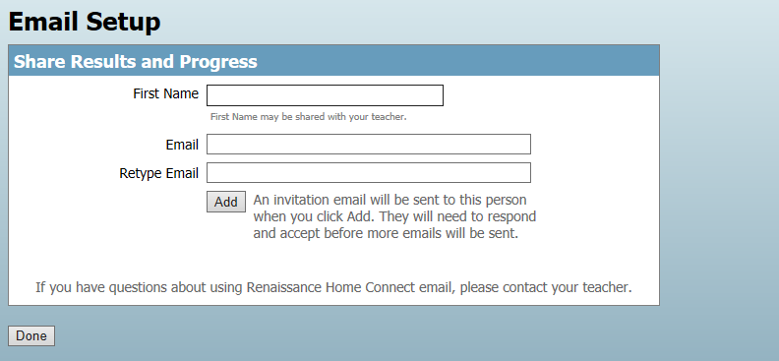
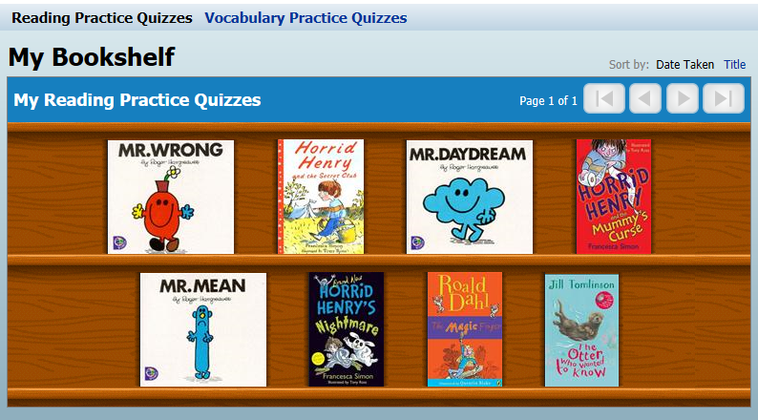
Home Connect for Parents/Carers

Slide 8
Any questions?

